Slide 1
How to Expand Health Care Coverage to Undocumented Immigrants?
Arturo Vargas Bustamante, PhD MPP
Associate Professor of Health Policy & Management
avb@ucla.edu

Slide 2
Agenda
Access to Care & Undocumented Immigrants
Policy Options
State Initiatives
Local and Community Initiatives

Slide 3
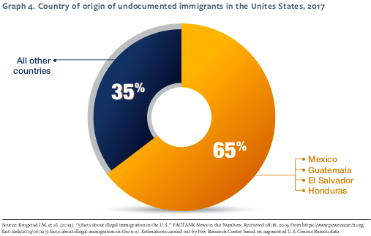

Slide 4
The Problem
Undocumented immigrants are ineligible to enroll in ACA-sponsored programs
Too many undocumented immigrants lack health insurance coverage and access to care
New “public charge” regulations are likely to discourage access to care even more
If present trends continue, undocumented adults will face increasing access to care barriers

Slide 5
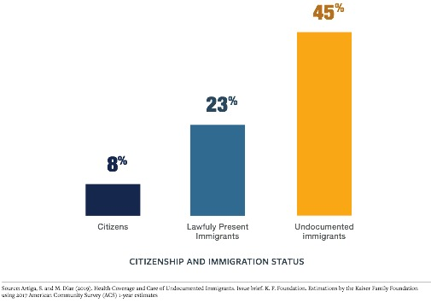

Slide 6
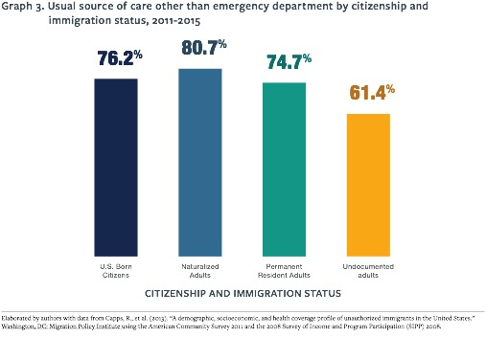

Slide 7
Policy Options
Assumption: Federal inaction - No short-term solution for undocumented immigrants
What can be done at the state and local level?
To identify policy options to expend coverage to the undocumented, we examined:
Innovations at the state and local level
Selected cases to identify best practices
Lessons & useful resources

Slide 8
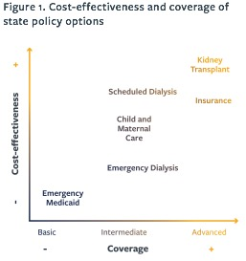

Slide 9
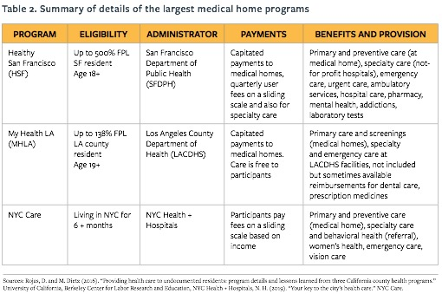

Slide 10
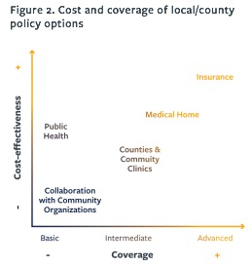

Slide 11
Conclusion
State and local governments can expand coverage to undocumented immigrants
Policy toolkit shows this variation and draws lessons
Available online:
https://healthequity.berkeley.edu/newsletter-february-2020

Slide 12
Acknowledgements
Funding for this research was provided by the California Initiative for Health Equity & Action (Cal-IHEA), a statewide health equity research translation center of the University of California. The authors’ views and recommendations do not necessarily represent those of Cal-IHEA or the Regents of the University of California.

Slide 13
How to Expand Health Care Coverage to Undocumented Immigrants?
Arturo Vargas Bustamante, PhD MPP
Associate Professor of Health Policy & Management
avb@ucla.edu

